Slide 1

Basic Details of the Team and Problem Statement
Organization Name : AICTE,MIC-Student Innovation
PS Code : SM949
Problem Statement Title : Local Bus Tracking System
Team Name : IRIS
Team Leader Name : KEERTHANA M
Institute Code (AISHE) : c-36989
Institute Name : KGiSL Institute of Technology
Theme Name : Transportation Logistics

Slide 2
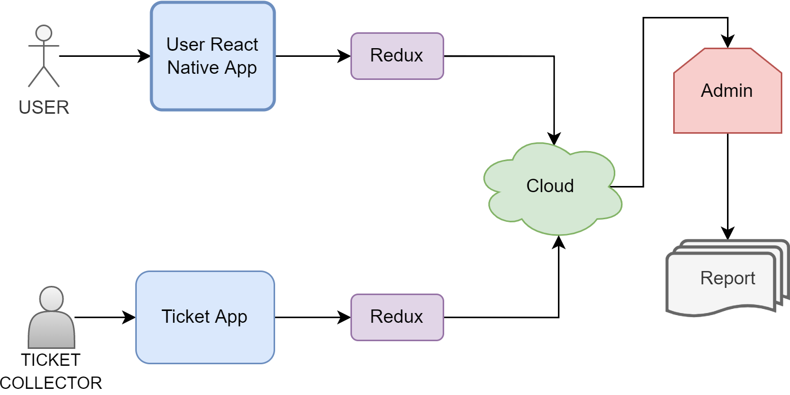
LOCAL BUS TRACKING SYSTEM
PROBLEM STATEMENT
Design and develop a smart system for public transport tracking (government bus) and tracking of seats availability through a connected thermal printer with the smart phone.
OVERALL USE CASE DIAGRAM
TECHNOLOGY STACK
React native (for UI)
Firebase (Database)
Cloud API service
MongoDB

Slide 3
USE CASES
A User will look for a particular bus or a list of bus that come across his location.
So here they find a source location of a user by himself selecting his location through the app.
The bus list will be given to them in the form of bus numbers.
And they looks for the particular bus which shows his particular location which is Destination.
The Route for the particular destination will also be shown
Thermal printer used for ticket connected with smart phone , also for tracking seats.
DEPENDENCIES
All the people who uses the public transportation on their day today life.
Local bus data
Cloud API service
Ticket count

Slide 4
Team Member Details
Team Leader Name: KEERTHANA M
Branch (Btech/Mtech/PhD etc): BTECH Stream (ECE, CSE etc): IT Year (I,II,III,IV): III
Team Member 1 Name: PUVIYARASU P
Branch (Btech/Mtech/PhD etc): BTECH Stream (ECE, CSE etc): IT Year (I,II,III,IV): III
Team Member 2 Name: GOWTHAMRAJ V P
Branch (Btech/Mtech/PhD etc): BTECH Stream (ECE, CSE etc): IT Year (I,II,III,IV): III
Team Member 3 Name: SIBIRAJ S
Branch (Btech/Mtech/PhD etc): BTECH Stream (ECE, CSE etc): IT Year (I,II,III,IV): III
Team Member 4 Name: VINITHA V
Branch (Btech/Mtech/PhD etc): BTECH Stream (ECE, CSE etc): IT Year (I,II,III,IV): III
Team Member 5 Name: ANUSUYA G
Branch (Btech/Mtech/PhD etc): BTECH Stream (ECE, CSE etc): IT Year (I,II,III,IV): III
Academic Mentor name: Dr.Hemalatha.B

